Slide 1
Assemble and disassemble a computer
Wuke Zhang
1-ASIR

Slide 2
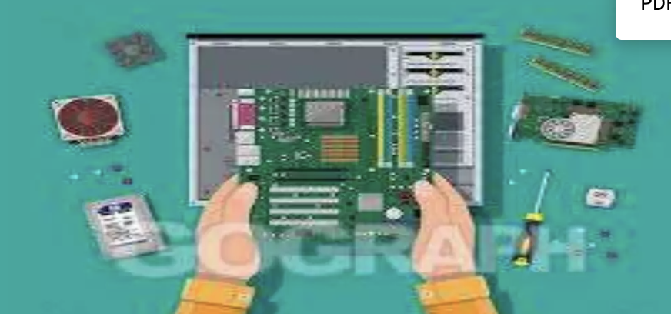
DEFINE
ASSEMBLE AND DISASSEMBLE

Slide 3
"Assembly" and "disassembly" are commonly used terms in the fields of manufacturing, engineering, and technology, particularly in reference to the process of putting together and taking apart physical products. Here are the definitions of both terms:
Assembly: Assembly refers to the process of joining multiple parts or individual components to form a complete product. This process involves the use of tools, machinery, and specific techniques to securely and efficiently connect the parts. During assembly, the individual parts are assembled according to a predetermined design to create a functional product.
Disassembly: Disassembly is the opposite process of assembly. It refers to the action of dismantling a complete product into its parts or individual components. This process may be carried out for various reasons, such as maintenance, repair, recycling, or material recovery. During disassembly, connections are undone, and the parts of the product are separated for further use or disposal.

Slide 4
Name the steps of assembling a computer hardware
Installing a:
Prepare Workspace: Choose a clean, static-free area.
Install PSU: Mount power supply unit in case and connect power cables.
Install Motherboard: Secure motherboard in case and connect power cables.
Install CPU: Insert CPU into motherboard socket and attach cooler.
Install RAM: Insert RAM sticks into motherboard slots.
Install Storage Drives: Mount HDDs/SSDs in drive bays and connect cables.
Install Expansion Cards: Insert GPU, sound card, etc., into motherboard slots.
Connect Front Panel: Connect power button, LEDs, etc., to motherboard.
Cable Management: Route cables neatly for airflow and aesthetics.
Close Case: Secure side panels of the case.
Test System: Power on, enter BIOS, install OS, and test stability.

Slide 5
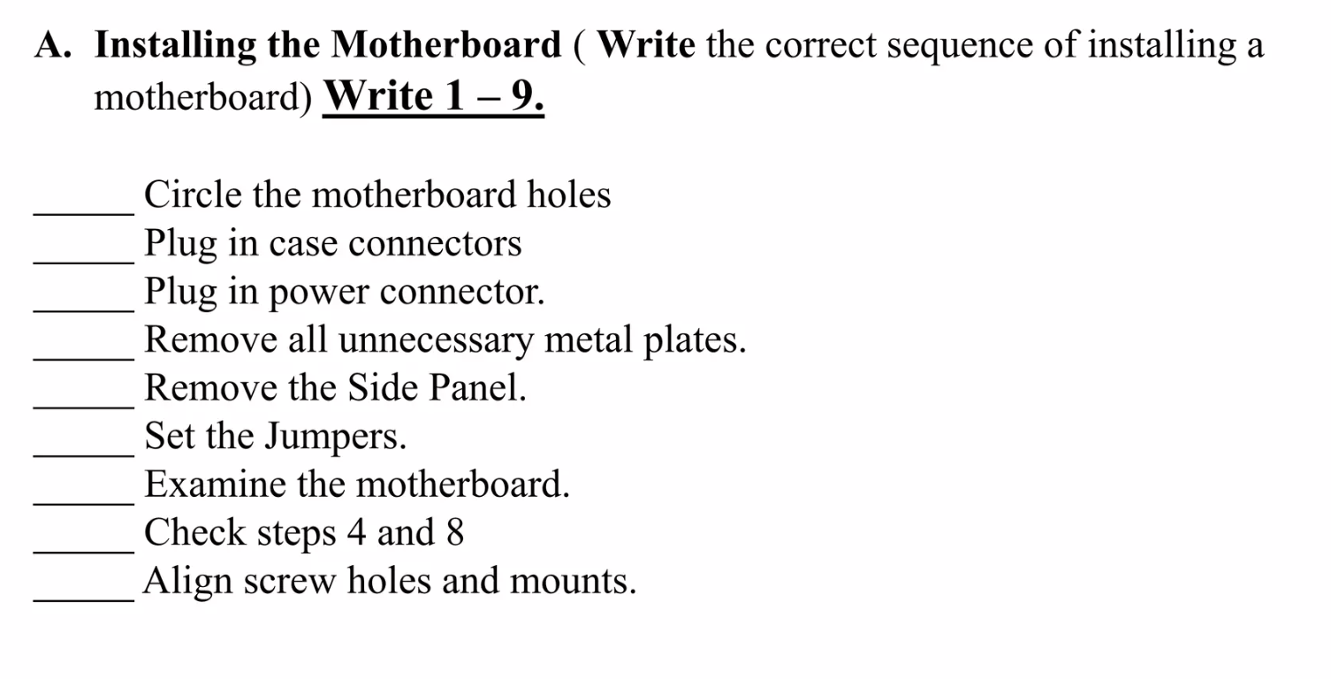
4
6
8
3
2
7
1
9
5

